Slide 1
History of Bangladesh
HST 103
T.4 Periodization (Medieval and Modern)

Slide 2
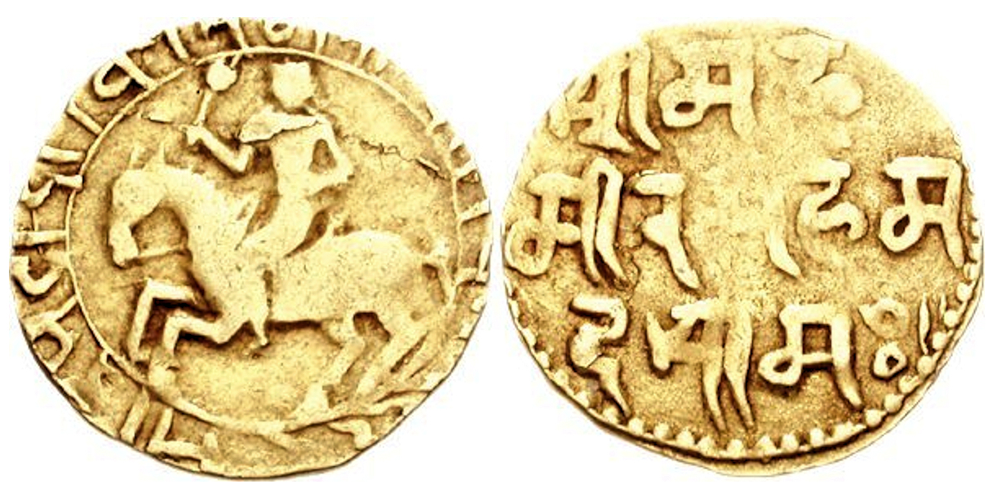
Medieval Period Conquest of Bengal by Ikhtiyar Uddin Muhammad bin Bakhtiyar Khalji
Muslim conquest of Bengal began with the capture of Nadia from the Sena dynasty in 1204 - Ikhtiyar Uddin Muhammad bin Bakhtiyar Khalji, a Turko-Afghan, became the founder of the Khalji dynasty of Bengal - ruled Bengal till 1227 CE
After this, Bengal was ruled by several other Muslim Sultans and Nawabs for over 500 years.

Slide 3
Medieval Period continued…
Ilyas Shahi dynasty (1342–1414 and 1435–1487)
In 1352, Shamsuddin Ilyas Shah unified the three small sultanates (Satgaon, laknauti, SONARGAO) in Bengal into a single government. Ilyas Shah proclaimed himself as the "Shah of Bangalah". He gave to this united territory the name of Bangalah and to the people thus integrated the name of Bangali.
He felt the necessity of introducing a good administration and thereby winning the support of the local people for maintaining the independence of his Sultanate. He gave the administration a popular character by offering liberal concessions to local elements and opened the government services to talent without any distinction of caste, creed or color. He was probably the first to make a large recruitment of the local people in the army.
End of Ilyas Shahi reign by an uprising organized by the sultan's premier Raja Ganesha, a Hindu aristocrat - later restored by Nasiruddin Mahmud Shah in 1435.

Slide 4
Medieval Period continued…
Hussain Shahi dynasty (1494–1538)
Bengal Sultanate's greatest territorial expansion under Alauddin Hussain Shah, founder of the Hussain Shahi dynasty - regarded by many historians as a golden age in which a syncretic Bengali culture that included elements of Muslim and Hindu traditions
He conquered Kamrup-Kamakhya (in Assam) and Orissa, and extended the Sultanate to the port of Chittagong
Under Alauddin Husain Shah the country enjoyed undisturbed peace and vijay gupta, the contemporary poet, mentioned him as nripati-tilaka (the tilak-mark of kings), jagatabhusana (the adornment of the universe) and Krsina-avatara (the incarnation of Krisna). His policy towards the Hindus was marked by tolerance and liberalism; some of the most important offices were held by Hindus. Under his patronization the Bangla version of MAHABHARATA was prepared.

Slide 5
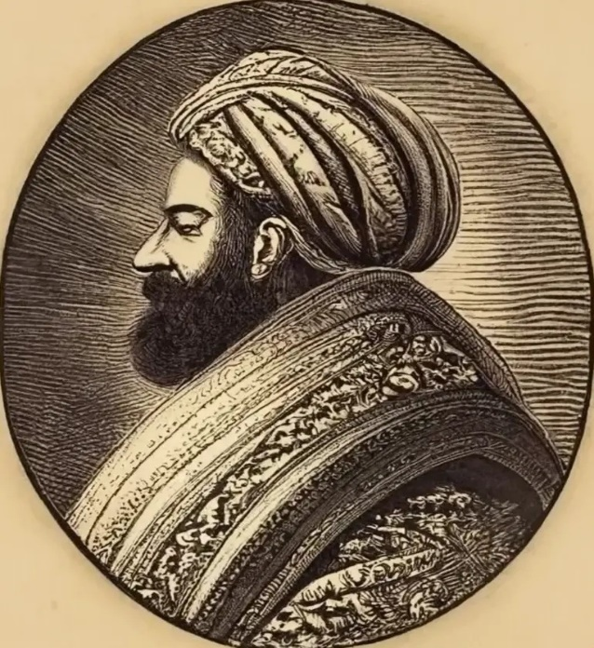
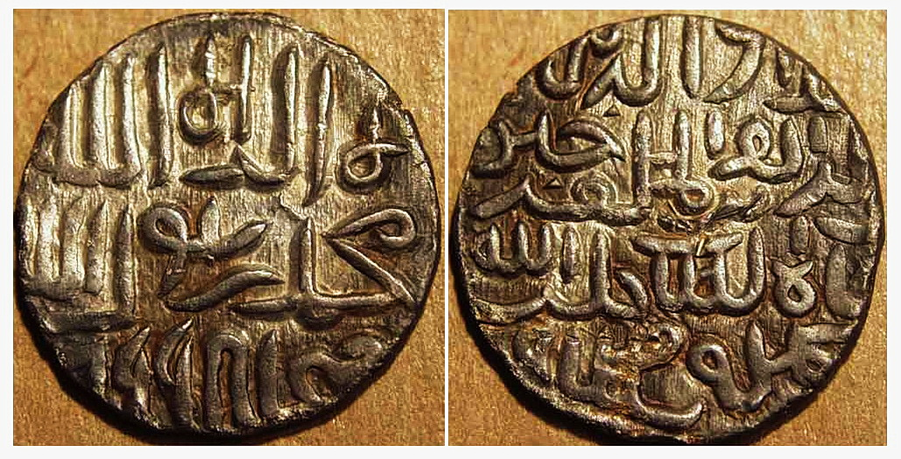
Coins of Alauddin Hussain Shah
Shamsuddin Ilyas Shah

Slide 6

Medieval Period continued…
Mughal Empire
Mirza Zahiruddin Muhammad Babur, ruler of Farghana (Uzbekistan) occupied India In 1525 - following the collapse of the Bengal Sultanate in the Battle of Raj Mahal in 1576, Bengal region was brought under Mughal control as the Bengal Subah during the rule of Jalāl al-Dīn Muḥammad Akbar (arguably the initiator of ‘Bangabda’).
The Bara Bhuiya put up strong resistance to the Mughals during the time of akbar and jahangir. The term Bara-Bhuiyans means twelve territorial landholders. The Bara-Bhuiyans rose to power in Eastern Bengal and put up resistance to the Mughals, until islam khan chisti made them submit in the reign of Jahangir.
Bengal became the largest and one of the most revenue earning provinces of Mughal empire
In 1717, the Mughal Court elevated the ‘Subahdar’ (Governor) rank to that of the hereditary ‘Nawab Nazim’ of Bengal, granting the region greater autonomy
Gradual decline of Mughal Empire after the demise of Aurangzeb in 1707 – eventually fragmented into different independent states.

Slide 7

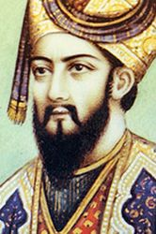
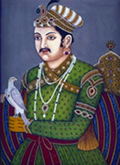
Emperor Babur and Akbar

Slide 8
End of Medieval Period
Nawabs of Bengal
By the 18th century, Mughal Bengal became a quasi-independent country under the nominal rule of the emperor in Delhi. The subahadar became hereditary Nawab Nazim - under the leadership of the Nawab of Bengal, the region established itself as an independent state, leading to increased prosperity
The Nasiri dynasty (1717–1740) was founded by the first Nawab of Bengal Murshid Quli Khan. When he died in 1727, his son-in-law Shuja-ud-din ruled Bengal till 1739.
Afsar dynasty (1740–1757)
The Afsar dynasty was founded by Alivardi Khan. His grandson and successor Siraj-ud-daulah was the last ‘independent’ Nawab of Bengal - defeated by British forces at the Battle of Palashi in 1757
Najafi dynasty Nawabs continued to rule as semi-independent till 1772, after which the British East India Company took complete control of Bengal

Slide 9
Modern Period
Bengal under the Colonial Rule (1765-1947)
British East India Company (1772–1858)
The British East India Company established its first settlements in Bengal around Hooghly during the 1630s
It received official permission to trade from Mughal viceroy Shah Shuja in 1651
Under the leadership of Robert Clive, British troops and their local allies decisively defeated the Nawab on 23 June 1757 at the Battle of Palashi (aka Plassey)
Mir Jafar was installed as Nawab with the support of the British East India Company. Eventually Mir Jafar was overthrown and replaced by his son-in-law Mir Qasim.
Mir Qasim was an effective and popular ruler. His defeat at the Battle of Buxar (1765) established the East India Company as a powerful force in the province of Bengal in a much more real sense than at Plassey seven years earlier.
In 1765, the East India Company gained Diwani rights, granting them the authority to collect revenue and administer civil justice in Bengal, Bihar, and Orissa. The Diwani rights, granted by Mughal Emperor Shah Alam II, provided the British with significant financial and administrative power, allowing them to exploit the region's resources and wealth.

Slide 10
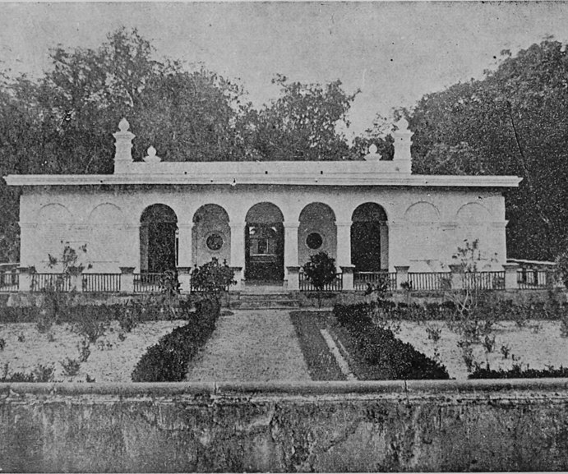
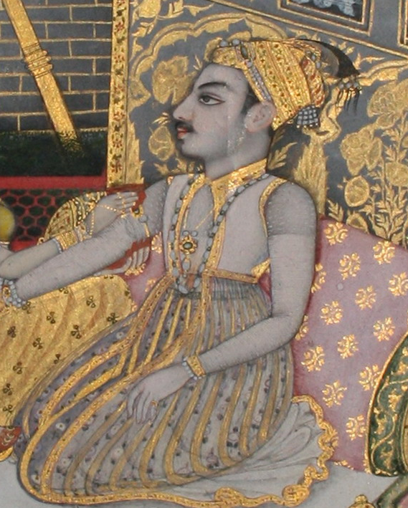
Siraj-ud-Daulah & his Masouleum

Slide 11
Modern Period (cond.)
British Crown Rule (1858–1947)
The Indian Rebellion of 1857 replaced the Company rule by with the direct control of Bengal by the British Crown - the Governor of Bengal concurrently became the Governor-General of India for many years
In 1877, when Queen Victoria took the title of "Empress of India", the British declared Calcutta the capital of the British Raj - Bengal Legislative Council was the principal lawmaking body in the province - it was created by the Indian Councils Act 1861, the Indian Councils Act 1909, the Government of India Act 1919 and the Government of India Act 1935
The partition of Bengal in 1947 left a deep impact on the people of Bengal. The Indian National Congress and the Hindu Mahasabha on one side and the Muslim League on the other were in favor of partitioning Bengal along religious lines - as a result, Bengal was divided into the state of West Bengal of India while the province of East Bengal under Pakistan, renamed East Pakistan in 1955.
Some other European Settlements in Bengal
Portuguese in Chittagong (1528–1666)
Dutch settlements (1610–1824)
French settlements (1692–1952)
Danish settlements (1625–1845)

Slide 12
Modern Period (contd.)
Emergence of Bangladesh
Bangladesh as East Bengal (1947-1955): From the early historic period, Bangladesh (Banga, Bengal, East Bengal) was a part of India. In 1947, it became a part of Pakistan as East Bengal.
Bangladesh as East Pakistan (1955-1971) : under the One Unit Policy, East Bengal was renamed East Pakistan by Pakistani Prime Minister Mohammad Ali of Bogra
Independent Bangladesh (1971- till date)
In 1971, West Pakistan started a military crackdown on Bangladesh (former East Pakistan) leading to the Bangladesh Liberation War - this led to the creation of Bangladesh on 16 December 1971.

